Slide 1

Specialization
.Net Core, CLR Internals, VS 2017
C# 6.0, WPF 4.5 .2 with Blend
ASP.Net Core, ASP.Net MVC 6.0
Linq 4 & ADO.Net EF 7.0
WCF 4.5.1, Web API, WF 4.5.1
RPA with Blue PRISM
Cloud Computing (Azure)
UML 2 and OOAD
HTML 5, CSS 3, SASS/LESS
65 Design Patterns
Adv. JavaScript, Jquery 2.x , Bootstrap
ES6,Typescript, Angular 4.0 /AoT,
ng-redux, Immutable, React with Redux
Backbone, Kendo UI, Ext js 6.x
Node.js,hapi.js, Mongo,node-gyp
Node & Angular Microservices with Docker
Mocha, QUnit, Jasmine, Karma
Docker, Webpack, Grunt,Gulp
D.S.R.Murthy M.Tech (IT)
Software Architect & Corporate Trainer
Experience : 26 years

Slide 2
MongoDB Topics
Day 1:
Introduction to Mongodb
Installing Mongodb and Robo 3T UI tool
Mongodb Terminlogy (Database,Documents,Collections,Fields)
Modelling database
Working with Mongod, Mongo shell
Configuring editor (sublime Text 3.0) for mongo shell
Application Design
CRUD in Mongodb
Querying
Selectors
Aggregation
Modifiers

Slide 3
MongoDB Topics
Day 2:
Working with Indexing for performance
MongoDB and MongodbClient application on Node JS
Working with Mongoose with Node JS
REST with MongoDB (Realtime Application)
Database Administration
Replication
Sharding
Automicity & Transaction-like symantics
Best Practises in Mongodb
Case study on Mongodb with Express on Node JS

Slide 4
MONGO DB 3.x – Features
MongoDB is a powerful, flexible, and scalable general-purpose document-oriented NoSQL family database.
Ability to scale out with features such as secondary indexes, range queries, sorting, and Aggregations
MongoDB is an open-source document database written in C++.
MongoDB is a cross-platform that provides, high performance, high availability, and easy scalability.
Created by 10Gen in 2009
OS support : windows, Unix, Solaris

Slide 5
MONGO DB 3.x – Motivation

Slide 6
MONGO DB 3.x
Where mongodb fits?
Big Data
Content Management and Delivery
Mobile and Social Infrastructure
User Data Management
Data Hub

Slide 7















Mongo DB in Production
http://www.mongodb.org/about/production-deployments/

Slide 8








NOSQL family
Key-value
Graph database
Document-oriented
Column family
8

Slide 9

MONGO DB 3.x
MongoDB does not need any pre-defined data schema
Every document could have different data!
{name: “raj”,
eyes: “blue”,
birthplace: “AP”,
aliases: [“raj”,
“kumar”],
loc: [32.7, 63.4],
boss: ”sriram”}
{name: “ravi”,
eyes: “blue”,
loc: [40.7, 73.4],
boss: “sriram”}
{name: “john”,
aliases: [“el diablo”]}
{name: “maduri”,
height: 72,
loc: [44.6, 71.3]}
{name: “kiran”,
hat: ”yes”}

Slide 10
MONGO DB 3.x – Features
Document-Oriented storage
Full Index Support
Replication & High Availability
Sharding
Querying
Fast In-Place Updates
Map/Reduce
Export / Import
Logging
Agile
Scalable

Slide 11
MONGO DB 3.x

Slide 12
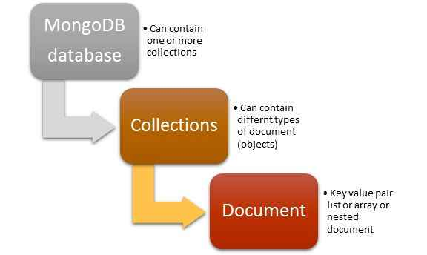
MONGO DB 3.x

Slide 13
MONGO DB 3.x – Document Store
RDBMS |  | MongoDB
Database |  | Database
Table, View |  | Collection
Row |  | Document (JSON, BSON)
Column |  | Field
Index |  | Index
Join |  | Embedded Document
Foreign Key |  | Reference
Partition |  | Shard
_id |  | Primary key
SQL Query |  | BSON Query
> db.user.findOne({age:50})
{
"_id" : ObjectId("5114e0bd42…"),
"first" : “Murthy",
"last" : “Sriram",
"age" : 50,
"interests" : [
"Reading",
“Music”]
"favorites": {
"color": "Blue",
"sport": “Chess"}
}

Slide 14
MONGO DB 3.x Architecture
MongoDB default Storage engine is WiredTiger from mongodb 3.0 onwards.
specify the --storageEngine to configure.
WiredTiger Features:
Document Level Concurrency
WiredTiger uses document-level concurrency control for write operations. As a result, multiple clients can modify different documents of a collection at the same time.
For most read and write operations, WiredTiger uses optimistic concurrency control. WiredTiger uses only intent locks at the global, database and collection levels.
When the storage engine detects conflicts between two operations, one will incur a write conflict causing MongoDB to transparently retry that operation.

Slide 15
MONGO DB 3.x Architecture
WiredTiger Features:
Snapshots and Checkpoints
WiredTiger uses MultiVersion Concurrency Control (MVCC). At the start of an operation, WiredTiger provides a point-in-time snapshot of the data to the transaction. A snapshot presents a consistent view of the in-memory data.
When writing to disk, WiredTiger writes all the data in a snapshot to disk in a consistent way across all data files.
. The checkpoint ensures that the data files are consistent up to and including the last checkpoint; i.e. checkpoints can act as recovery points.
MongoDB configures WiredTiger to create checkpoints (i.e. write the snapshot data to disk) at intervals of 60 seconds

Slide 16
MONGO DB 3.x Architecture
WiredTiger Features:
Journal
WiredTiger uses a write-ahead transaction log in combination with checkpoints to ensure data durability.
The WiredTiger journal persists all data modifications between checkpoints.
If MongoDB exits between checkpoints, it uses the journal to replay all data modified since the last checkpoint.

Slide 17
MONGO DB 3.x Architecture
WiredTiger Features:
Compression
With WiredTiger, MongoDB supports compression for all collections and indexes.
Compression minimizes storage use at the expense of additional CPU.
By default, WiredTiger uses block compression with the snappy compression library for all collections and prefix compression for all indexes.

Slide 18
MONGO DB 3.x Architecture
WiredTiger Features:
Memory Use
With WiredTiger, MongoDB utilizes both the WiredTiger internal cache and the file system cache.
Starting in 3.4, the WiredTiger internal cache, by default, will use the larger of either:
50% of RAM minus 1 GB, or 256 MB.
By default, WiredTiger uses Snappy block compression for all collections and prefix compression for all indexes.
For more information : see Mongodb 3.4 documentation.

Slide 19



MONGO DB 3.x –
Fast and Scalable
Better data locality
In-Memory
Caching
Distributed Architecture
Replication /HA
Relational
MongoDB
Horizontal Scaling

Slide 20
MONGO DB 3.x –

Slide 21
MONGO DB 3.x –

Slide 22
MONGO DB 3.x - Features
CRUD
Create
db.collection.insert( <document> )
db.collection.save( <document> )
db.collection.update( <query>, <update>, { upsert: true } )
Read
db.collection.find( <query>, <projection> )
db.collection.findOne( <query>, <projection> )
Update
db.collection.update( <query>, <update>, <options> )
Delete
db.collection.remove( <query>, <justOne> )

Slide 23
MONGO DB 3.x - Shell to perform CRUD
> db.user.insert({
first: “murthy",
last : “sriram",
age: 50
})
> db.user.find ()
{
"_id" : ObjectId("51…"),
"first" : “murthy",
"last" : “sriram",
"age" : 50
}
> db.user.update(
{"_id" : ObjectId("51…")},
{
$set: {
age: 51,
salary: 7000}
}
)
> db.user.remove({
"first": /^m/
})

Slide 24
MONGO DB 3.x
Databases
- A single instance of MongoDB can host several databases, each grouping
together zero or more collections.
A database has its own permissions, and each database is stored in separate files on disk.
Separate databases are useful when storing data for several application or users on the same MongoDB server.

Slide 25
MONGO DB 3.x - Types of database names
admin
This is the “root” database, in terms of authentication. If a user is added to the admin database, the user automatically inherits permissions for all databases.
local
This database will never be replicated and can be used to store any collections that should be local to a single server
config
When MongoDB is being used in a sharded setup , it uses the config
database to store information about the shards.

Slide 26
MONGO DB 3.x
Documents
an ordered set of keys with associated values represented as objects
{“name" : “Murthy", “salary" : 6000} (Type sensitive and case sensitive)
We can also have embedded documents
Collections
A collection is a group of documents.
Dynamic Schemas
Collections have dynamic schemas means that the documents within a single collection can have any number of different “shapes.”
{“name" : “murthy"}
{“address" : “Hyderabad”}

Slide 27
MONGO DB 3.x - Data Types
null
Null can be used to represent both a null value and a non existent field:
{"x" : null}
boolean
{"x" : true}
number
The shell defaults to using 64-bit floating point numbers.
{"x" : 3.14}
string
Any string of UTF-8 characters can be represented using the string type:
{"x" : "foobar"}
date
Dates are stored as milliseconds since the epoch. The time zone is not stored:
{"x" : new Date()}

Slide 28
MONGO DB 3.x - Data types
regular expression
Queries can use regular expressions using JavaScript’s regular expression syntax:
{"x" : /foobar/i}
array
Sets or lists of values can be represented as arrays:
{"x" : ["a", "b", "c"]}
embedded document
Documents can contain entire documents embedded as values in a parent doc.
{
"name" : “Murthy",
"address" : {
"street" : “DD colony","city" : “Hyderabad","state" : “AP"}
}

Slide 29
MONGO DB 3.x - Data types
object id
An object id is a 12-byte ID for documents.
{"x" : ObjectId()}
binary data
Binary data is a string of arbitrary bytes. It cannot be manipulated from the shell.
Binary data is the only way to save non-UTF-8 strings to the database.
code
Queries and documents can also contain arbitrary JavaScript code:
{"x" : function() { /* ... */ }}

Slide 30
MONGO DB 3.x - Data types
_id and ObjectIds (like Primary key)
Every document stored in MongoDB must have an "_id" key. The "_id" key’s value can be any type, but it defaults to an ObjectId.
ObjectIds
ObjectId is the default type for "_id". The ObjectId class is designed to be lightweight to generate in a globally unique way across different machines.
0 1 2 3 4 5 6 7 8 9 10 11
Timestamp Machine PID Increment

Slide 31
MONGO DB 3.x - Data types Summary
String : This is most commonly used datatype to store the data.
Integer : This type is used to store a numerical value
Boolean : This type is used to store a boolean (true/ false) value.
Double : This type is used to store floating point values.
Min/ Max keys : used to compare a value against the lowest and highest BSON Arrays : used to store arrays or list or multiple values into one key.
Timestamp : timestamp.
Object : This datatype is used for embedded documents.
Null : This type is used to store a Null value.
Symbol : This datatype is used identically to a string however
Date : This datatype is used to store the current date or time.
Object ID : This datatype is used to store the document’s ID.
Binary data : This datatype is used to store binay data.
Code : This datatype is used to store javascript code into document.
Regular expression : This datatype is used to store regular expression

Slide 32
MONGO DB 3.x
Example
Suppose a client needs a database design for his blog website:
Every post has the unique title, description and url.
Every post can have one or more tags.
Every post has the name of its publisher and total number of likes.
Every Post have comments given by users along with their name, message, data-time and likes.
On each post there can be zero or more comments.

Slide 33
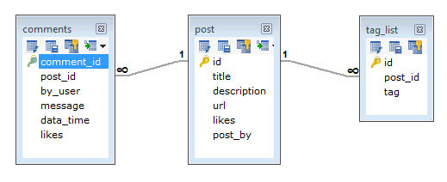
MONGO DB 3.x
Mongo DB

Slide 34
MONGO DB 3.x
Schema
{ _id: POST_ID
title: TITLE_OF_POST,
description: POST_DESCRIPTION,
by: POST_BY,
url: URL_OF_POST,
tags: [TAG1, TAG2, TAG3],
likes: TOTAL_LIKES,
comments: [
{ user:'COMMENT_BY',
message: TEXT,
dateCreated: DATE_TIME,
like: LIKES
},
{ user:'COMMENT_BY',
message: TEXT,
dateCreated: DATE_TIME,
like: LIKES } ]}
in mongodb data will be shown from one collection only

Slide 35
MONGO DB 3.x
Mongo DB
>use blogdb
>db.blog.insert(
{
title: 'MongoDB Overview',
description: 'MongoDB is no sql database',
by: ‘murthy',
url: 'http://murthyblog.com',
tags: ['mongodb', 'database', 'NoSQL'],
likes: 100
})

Slide 36
MONGO DB 3.x
Mongo DB
>db.blog.find()
>db. blog.find().pretty() display in formatted way
>db.blog.findOne({_id:123})
>db.blog.find().pretty().sort({user:1})
>db.blog.find({"by":“murthy","title": "MongoDB Overview"}).pretty() // and logic
>db.blog.find({$or:[{"by":“murthy"},{"title": "MongoDB Overview"}]}).pretty() // or logic
>db.blog.find({"likes": {$gt:10}, $or: [{"by": “murthy"},{"title": "MongoDB Overview"}]}).pretty()

Slide 37
MONGO DB 3.x
Mongo DB
>db.blog.update({'title':'MongoDB Overview'},
{$set:{'title':'New MongoDB '}})
>db.blog.find()

Slide 38
MONGO DB 3.x
Mongo DB
Limit records :
> db.blog.find().limit(2)
Skip record:
> db.blog.find().limit(1).skip(1)
Index
> db.blog.ensureIndex({“user":1})
Aggregation
db.blog.aggregate([{$group : {_id : "$by_user", likes : {$sum : 1}}}])

Slide 39
MONGO DB 3.x
Mongo DB
The remove() Method
remove() method is used to remove document from the collection. remove() method accepts two parameters. One is deletion criteria and second is justOne flag
deletion criteria : (Optional) deletion criteria according to documents will be removed.
justOne : (Optional) if set to true or 1, then remove only one document.
>db.COLLECTION_NAME.remove(DELLETION_CRITTERIA)
>db.blog.remove({'title':'MongoDB Overview'}) // remove one
>db.blog.remove()
>db.blog.find()

Slide 40
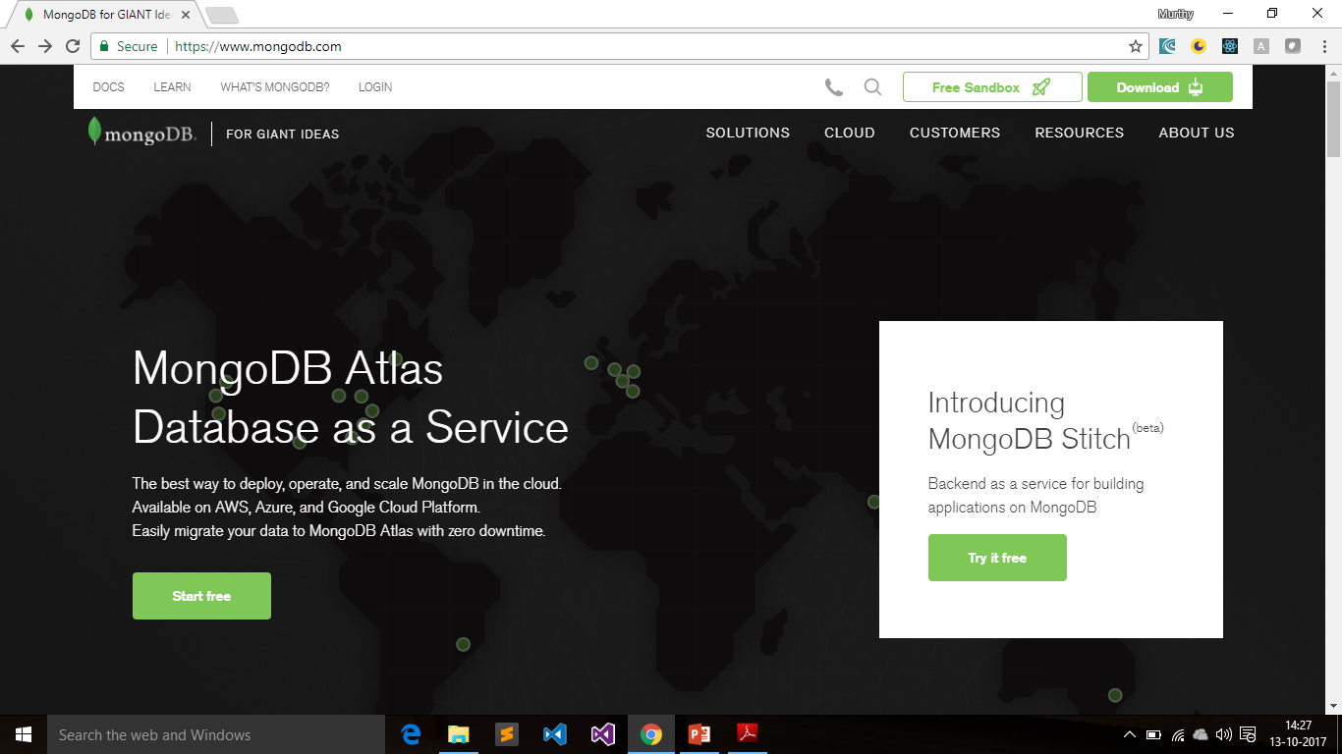
MONGO DB Setup

Slide 41
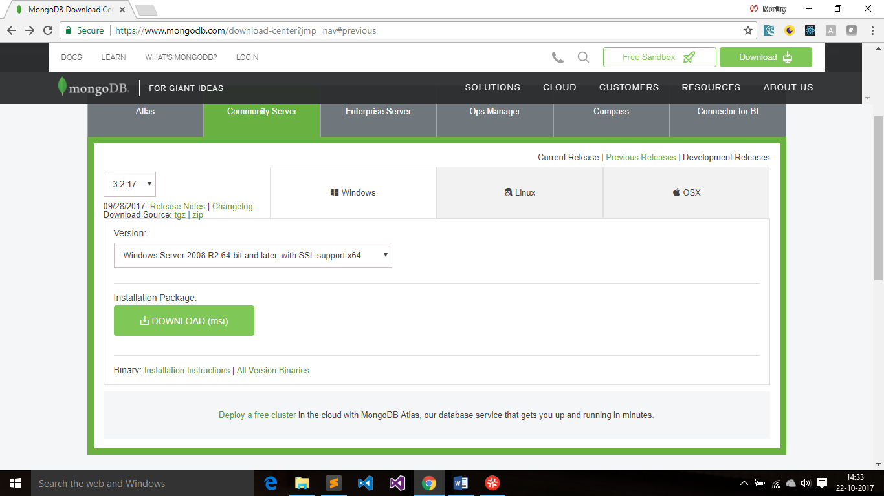
MONGO DB Setup
Install mongodb3.2.msi
Observe c:\program files\mongodb\

Slide 42
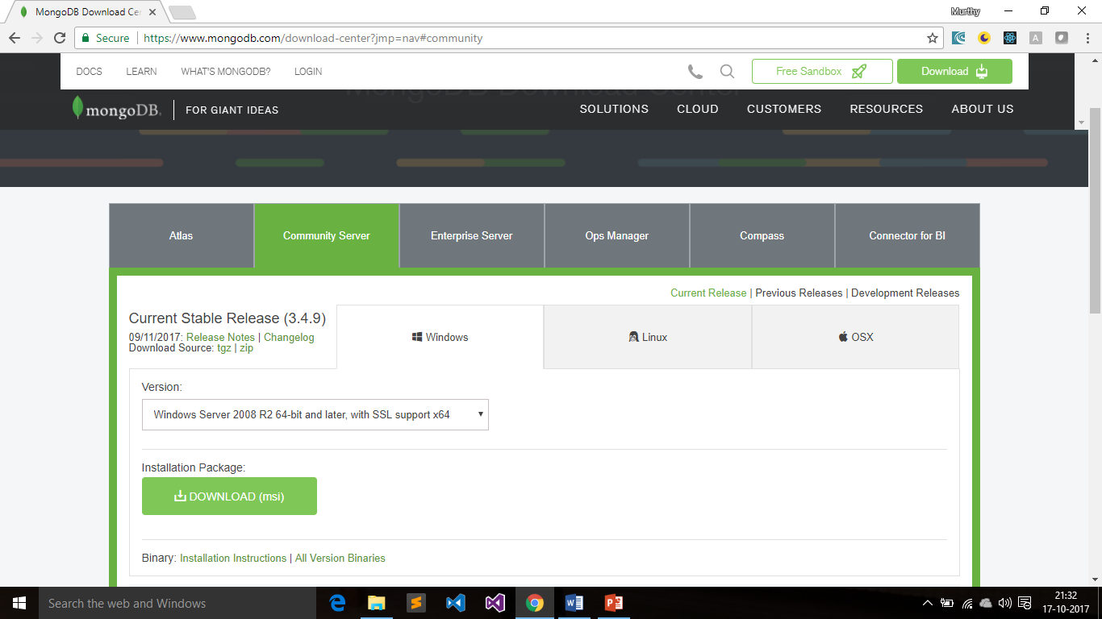
MONGO DB Setup

Slide 43
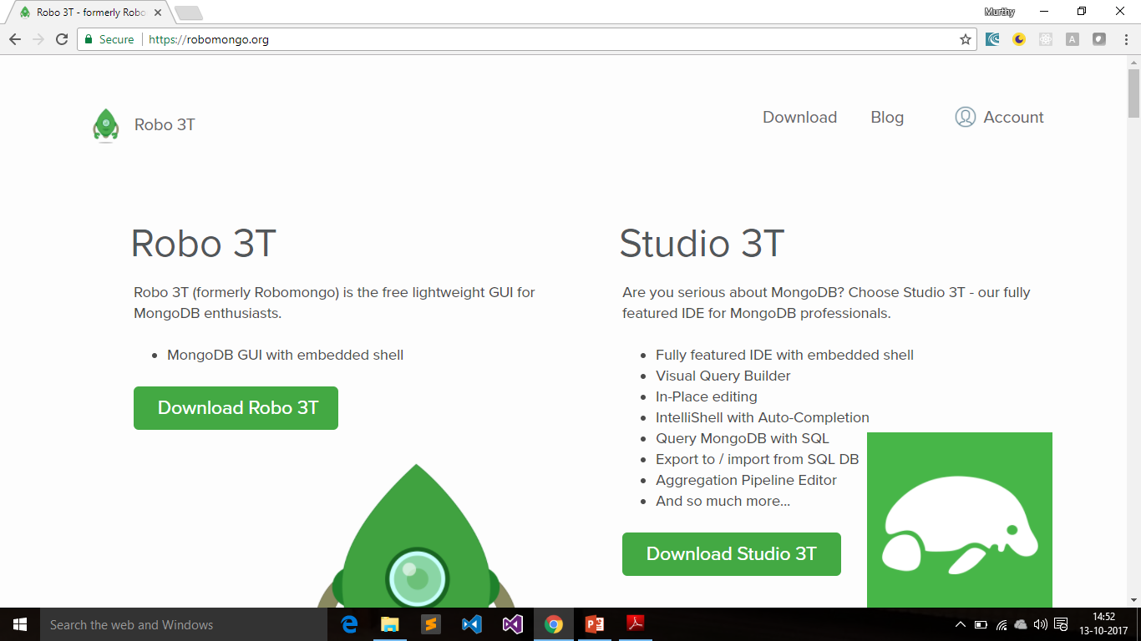
ROBO 3T – MongoDB GUI

Slide 44
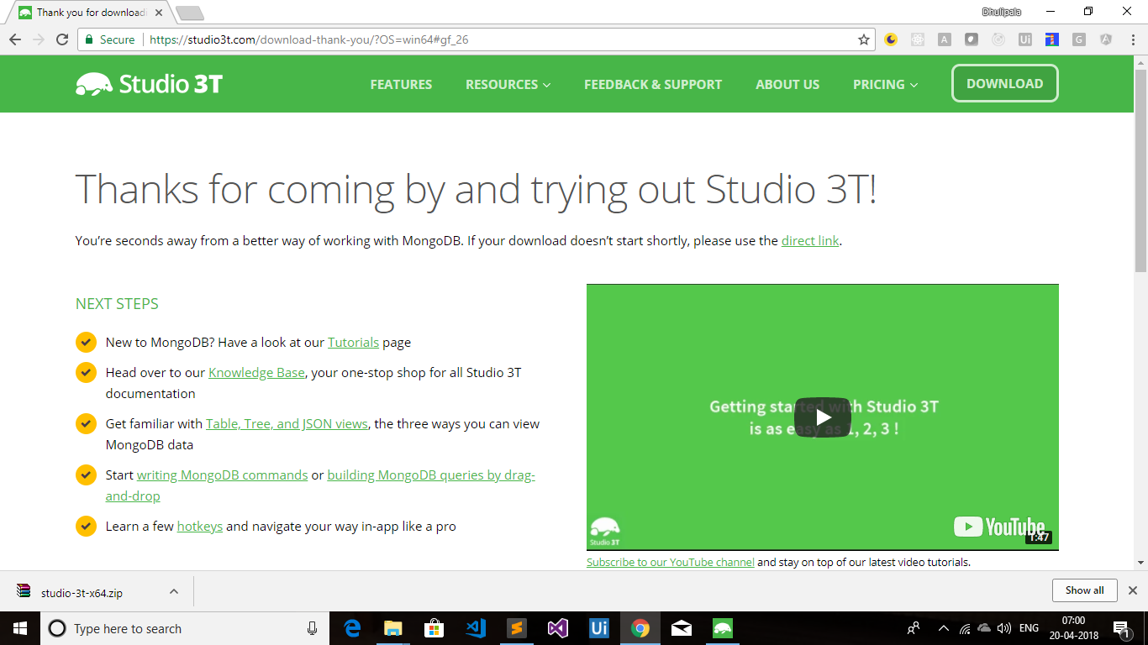
ROBO 3T – MongoDB GUI

Slide 45
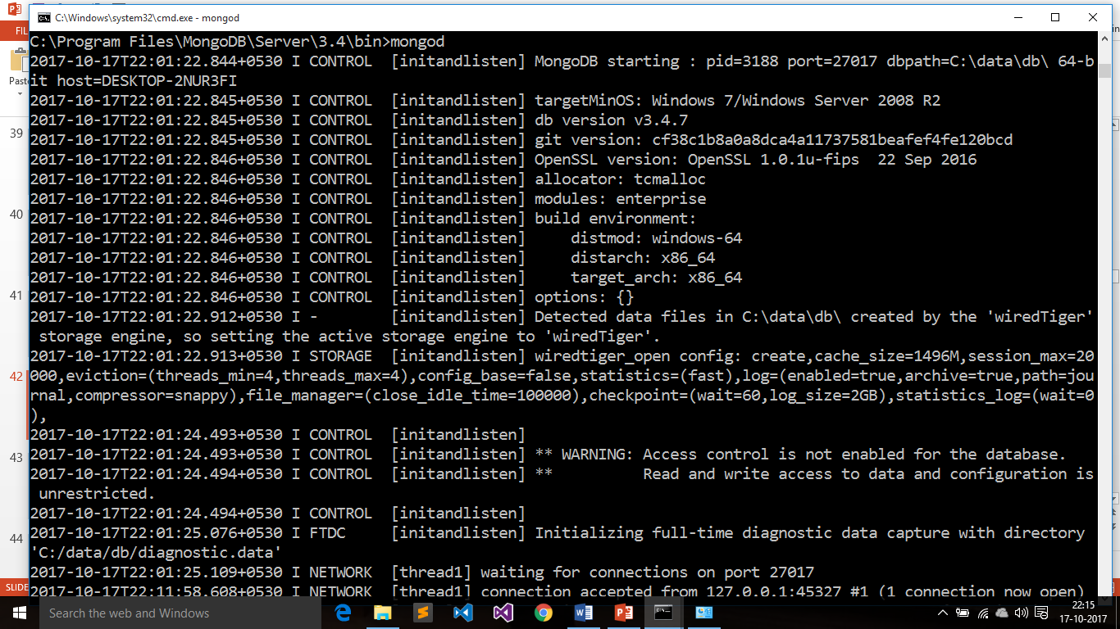
MONGO DB 3.x - Starting DB
Create a folder \data\db in ‘C’ drive
Start Mongodb > mongod

Slide 46
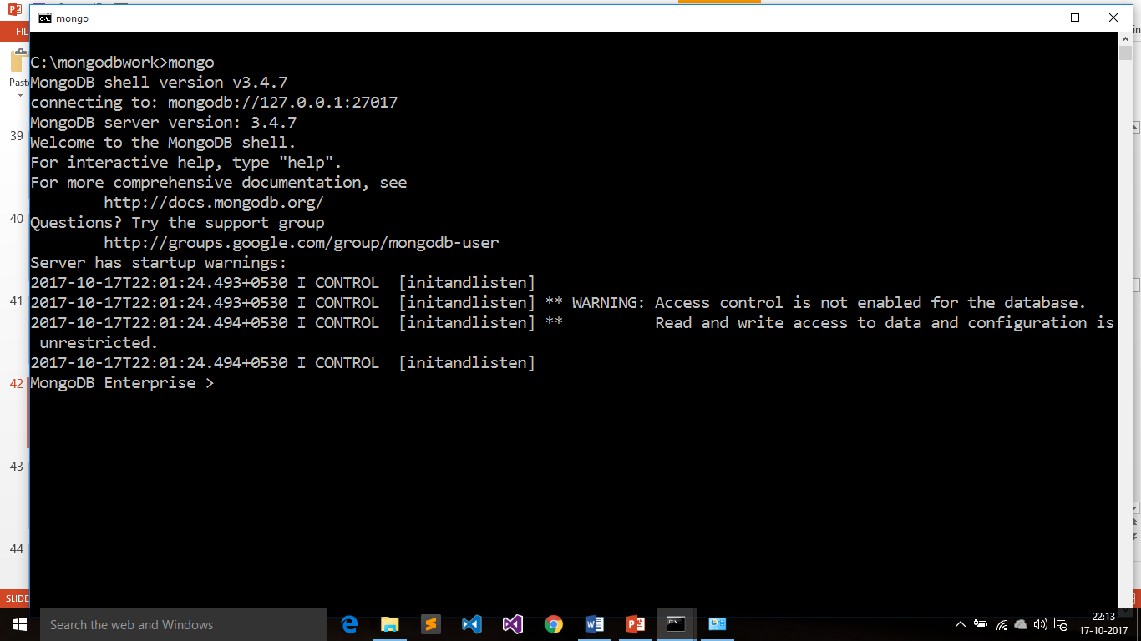
MONGO DB 3.x - Starting DB
Run Mongo Shell > mongo

Slide 47
MONGO DB 3.x - Starting DB
Create a folder \data\db in ‘C’ drive
Start Mongodb > mongod
By default mongodb starts on port : 27017
Running the Shell
$ mongo (or $ mongo some-host:30000/myDB)
MongoDB shell version: 3.4.2
connecting to: test
> (this is REPL for MongoClient)
The shell is a full-featured JavaScript interpreter, capable of running arbitrary JavaScript programs.
> x = 200
200

Slide 48
MONGO DB 3.x - Mongo Shell
$ mongo –nodb (not connected to any db)
MongoDB shell version: 2.4.0
>
> conn = new Mongo("some-host:30000")
connection to some-host:30000
> db = conn.getDB(“testDB")
testDB
Now you can use testDB normally.
$ mongo script1.js (running javascript shell code)

Slide 49
MONGO DB 3.x - Mongo Shell
Extract the archive and navigate to the bin subfolder. Observe mongod which is the server process and mongo is the client shell
Create a new text file in the bin subfolder named mongodb.config.
Add a single line in mongodb.config:
Eg : dbpath=c:\data\db
Launch mongod
c:\mongodb\bin\mongod --config c:\mongodb\bin\mongodb.config
>db.version()
db.version()
db.help()
db.stats()
db.getCollectionNames()

Slide 50
MONGO DB 3.x - Java script Shell
>db
test
>use customer
switched to customer
>db
customer

Slide 51
MONGO DB 3.x - Shell to perform CRUD
Create
The insert function adds a document to a collection.
> post = {"title" : "Murthy Blog Post",
... "content" : "Here's my blog post.",
... "date" : new Date()}
This object is a valid MongoDB document, now save it to the blog collection using the insert method:
> db.blog.insert(post)

Slide 52
MONGO DB 3.x - Shell to perform CRUD
Read
find and findOne can be used to query a collection
> db.blog.findOne()
Update
> post.comments = []
Then we perform the update, replacing the post titled “My Blog Post” with new version of the document:
> db.blog.update({title : "My Blog Post"}, post)
> db.blog.find()
Delete
> db.blog.remove({title : "My Blog Post"})

Slide 53
MONGO DB 3.x - Mongo shell script
// defineConnectTo.js
/**
* Connect to a database and set db.
*/
var connectTo = function(port, dbname) {
if (!port) {
port = 27017;
}
if (!dbname) {
dbname = "testDB";
}
db = connect("localhost:"+port+"/"+dbname);
return db;
};
If we load this script in the shell, connectTo is now defined:
> typeof connectTo
Undefined
>load('defineConnectTo.js')
> typeof connectTo
function

Slide 54
MONGO DB 3.x - Mongo shell script
Creating a .mongorc.js
To hve frequently-loaded scripts, write in mongorc.js file.
This file is run whenever we start up the shell.
.mongorc.js (create this in home directory of Mongodb)
var compliment = ["attractive", "intelligent", "like Batman"];
var index = Math.floor(Math.random()*3);
print("Hello, you're looking particularly "+compliment[index]+" today!");
$ mongo
MongoDB shell version: 3.4.2-preconnecting
to: testDB
Hello, you're looking particularly like Batman today!

Slide 55
CRUD & Querying with MongoDB

Slide 56
MONGO DB 3.x - Mongo shell script
Inserting :
> db.customer.insert({“name" : “Murthy"})
Batch Insert:
> db.foo.batchInsert([{"_id" : 0}, {"_id" : 1}, {"_id" : 2}])
> db.foo.find()
Removing:
> db.customer.remove() (This will remove all of the documents in collection)
Update ($set/$unset)
> db.customer.update({"_id" : ObjectId("4b253b067525f35f94b60a31")},
... {"$set" : {“email" : “Murthy@yahoo.com"}})
> db.customer.findOne()

Slide 57
MONGO DB 3.x - Mongo shell script
Getting last error:
> db.foo.insert({"_id" : 1}); db.foo.insert({"_id" : 1}); print(
... db.getLastError()); db.foo.count()
E11000 duplicate key error index: test.foo.$_id_ dup key: { : 1.0 }

Slide 58
MONGO DB 3.x - Query
Introduction to find
The find method is used to perform queries in MongoDB. Querying returns a subset of documents in a collection.
Which documents get returned is determined by the first argument to find, which is a document specifying the query criteria.
An empty query document (i.e., {}) matches everything in the collection. If find isn’t given a query document, it defaults to {}.
For example, the following:
> db.c.find()
matches every document in the collection c (and returns these documents in batches).

Slide 59
MONGO DB 3.x - Query
Users collection:
>use trainingdb
>db.users.insert({
username:’murthy’,
age:50,
registered:true,
email:’murthy@gmail.com’
address:{
street:’Tarnaka’,
city:’Hyderabad’,
State:’AP’,
zip:500013
}
})

Slide 60
MONGO DB 3.x - Query
> db.users.find({"age" : 27})
> db.users.find({"username" : “murthy"})
> db.users.find({"username" : “murthy", "age" : 27})
Query Criteria:
"$lt", "$lte", "$gt", and "$gte" are all comparison operators, corresponding to <,
<=, >, and >=, respectively.
> db.users.find({"age" : {"$gte" : 18, "$lte" : 30}}) (and)
> start = new Date("01/01/2017")
db.users.find({"registered" : {"$lt" : start}})
> db.users.find({"user_id" : {"$in" : [12345, 14323,12432]}) (or query)

Slide 61
MONGO DB 3.x - Query
> db.users.find({"$or" : [{“username" : “murthy}, {“age" : 27}]}) ( $or )
> db.users.find({"id_num" : {"$not" : {"$mod" : [5, 1]}}}) ($not)
>db.users.find({“username" : /murthy/i}) (Regular exp)
Querying embedded document:
> db.people.find({“address.zip" : 500013})

Slide 62
MONGO DB 3.x - Query
Cursors
The database returns results from find using a cursor.
With Cursor, we can limit the number of results, skip over results, sort results by any combination of keys in any direction, and perform a number of other powerful operations.
> for(i=0; i<100; i++) {
... db.collection.insert({x : i});
... }
var cursor = db.collection.find();
> while (cursor.hasNext()) {
... obj = cursor.next();
... // do stuff
... }
> var cursor = db.users.find();
> cursor.forEach(function(x) {
... print(x.name);
... });

Slide 63
MONGO DB 3.x - Query
> db.users.find().limit(3)
> db.users.find().skip(3)
> db.users.find().sort({username : 1, age : -1})
> var cursor = db.foo.find().sort({"x" : 1}).limit(1).skip(10);
> var cursor = db.foo.find().limit(1).sort({"x" : 1}).skip(10);
> var cursor = db.foo.find().skip(10).limit(1).sort({"x" : 1});

Slide 64
MONGO DB 3.x - Query
Database Commands:
useful for data manipulation, administration, and monitoring.
For example, dropping a collection is done via the "drop" database command:
> db.runCommand({"drop" : "test"});
{
"nIndexesWas" : 1,
"msg" : "indexes dropped for collection",
"ns" : "test.test",
"ok" : true
}
Or
> db.test.drop()

Slide 65
MONGO DB 3.x - Query
Database Commands:
> db.count.update({x : 1}, {$inc : {x : 1}}, false, true)
> db.runCommand({getLastError : 1})
{
"err" : null,
"updatedExisting" : true,
"n" : 5,
"ok" : true
}

Slide 66
MONGO DB 3.x - Query
Database Commands:
> use temp
switched to db temp
Shutting down Database
> db.runCommand({shutdown:1})
{ "errmsg" : "access denied; use admin db", "ok" : 0 }
> db.adminCommand({"shutdown" : 1})

Slide 67
Indexing – Application Design

Slide 68
Indexing
Indexing on collection allows fast access to big data.
create new indexes using the ensureIndex().
An index only needs to be created once per collection
All of the information about a database’s indexes is stored in the system.indexes collection.
This is a reserved collection
(cannot modify its documents or remove documents from it)
Manipulate it only through ensureIndex and the dropIndexes database command.
Run db.collectionName.getIndexes() to see all index information
> db.users.getIndexes()
> db.users.dropIndex(name) // to drop the index

Slide 69
Indexing
For Testing, create some documents in a users collection.
> for (i=0; i<1000; i++) {
... db.users.insert(
... {
... "i" : i,
... "username" : "user"+i,
... "age" : Math.floor(Math.random()*120),
... "created" : new Date()
... }
... );
... }

Slide 70
Indexing
explian() to get detailed information about the query.
> db.users.find({"age" : 42}).explain(“executionStats”)

Slide 71
Indexing
Index on the username field:
(Note: MongoDB limits to 64 indexes per collection.)
db.users.ensureIndex({“age" : 1})
> db.users.find({“age" : 42}).explain(“executionStat”)

Slide 72
Indexing
Compound indexing: (indexing on more than one field)
Useful if query has multiple sort directions or multiple keys in the criteria.
db.users.ensureIndex({"age" : 1, "username" : 1})
> db.users.find({“age" : 42},”username”:”Murthy”).explain(“executionStat”)

Slide 73
Indexing
Suppose we have a users collection and if we run a query with
no sorting (called natural order):
> db.users.find({}, {"_id" : 0, "i" : 0, "created" : 0})
{ "username" : "user0", "age" : 69 }
{ "username" : "user1", "age" : 50 }
{ "username" : "user2", "age" : 88 }
{ "username" : "user3", "age" : 52 }
{ "username" : "user4", "age" : 74 }
{ "username" : "user5", "age" : 104 }
{ "username" : "user6", "age" : 59 }
{ "username" : "user7", "age" : 102 }
{ "username" : "user8", "age" : 94 }
{ "username" : "user9", "age" : 7 }
{ "username" : "user10", "age" : 80 }
...

Slide 74
Indexing
If we index this collection by {"age" : 1, "username" : 1}
[0, "user100309"] -> 0x0c965148
[0, "user100334"] -> 0xf51f818e
[0, "user100479"] -> 0x00fd7934
...
[0, "user99985" ] -> 0xd246648f
[1, "user100156"] -> 0xf78d5bdd
[1, "user100187"] -> 0x68ab28bd
[1, "user100192"] -> 0x5c7fb621
...
[1, "user999920"] -> 0x67ded4b7
[2, "user100141"] -> 0x3996dd46
[2, "user100149"] -> 0xfce68412
[2, "user100223"] -> 0x91106e23
Each index entry contains an age and a username and points to the location of a document on disk

Slide 75
Indexing
Point query vs Multi-value query:
> db.users.find({"age" : 21}).sort({"username" : -1})
This is a point query, which searches for a single value. Due to the second field in the index, the results are already in the correct order for the sort: MongoDB can start with the last match for {"age" : 21} and traverse the index in order:
[21, "user999977"] -> 0x9b3160cf
[21, "user999954"] -> 0xfe039231
[21, "user999902"] -> 0x719996aa
...
This type of query is very efficient: MongoDB can jump directly to the correct age and doesn’t need to sort the results as traversing the index returns the data in the correct order.

Slide 76
Indexing
> db.users.find({"age" : {"$gte" : 21, "$lte" : 30}})
This is a multi-value query, which looks for documents matching multiple values
MongoDB will use the first key in the index, "age", to return the matching documents
[21, "user100000"] -> 0x37555a81
[21, "user100069"] -> 0x6951d16f
[21, "user1001"] -> 0x9a1f5e0c
[21, "user100253"] -> 0xd54bd959
[21, "user100409"] -> 0x824fef6c
[21, "user100469"] -> 0x5fba778b
...
[30, "user999775"] -> 0x45182d8c
[30, "user999850"] -> 0x1df279e9
[30, "user999936"] -> 0x525caa57
In general, if MongoDB uses an index for a query it will return the resulting documents in index order.

Slide 77
Indexing
Indexing embedded docs for performance
Indexes can be created on keys in embedded documents.
{
"username" : "sid",
"loc" : {
"ip" : "1.2.3.4",
"city" : “Delhi",
"state" : “IN"
}
}
put an index on one of the subfields of "loc“ → "loc.city", to speed up queries using that field:
> db.users.ensureIndex({"loc.city" : 1})

Slide 78
Indexing
Unique Indexes
Unique indexes guarantee that each value will appear only once in the index.
> db.users.ensureIndex({"username" : 1}, {"unique" : true})
For example, suppose that we try to insert the following documents on the collection above:
> db.users.insert({username: “murthy"})
> db.users.insert({username: “murthy"})
E11000 duplicate key error index: test.users.$username_1 dup key: { : “murthy" }
A unique index on "_id", which is automatically created whenever we create a collection. This is a normal unique index.
> db.users.ensureIndex({"username" : 1}, {"unique" : true, "dropDups" : true})

Slide 79
Indexing
Time-To-Live Indexes
Time-to-live (TTL) indexes allow to set a timeout for each document. When a document reaches a preconfigured age, it will be deleted. This type of index is useful for caching problems like session storage.
Create a TTL index by specifying the expireAfterSecs option in the second argument to ensureIndex:
// 24-hour timeout
>db.logs.ensureIndex({"lastUpdated" : 1},
{"expireAfterSecs" : 60*60*24})

Slide 80
Capped Collection
Capped Collection:
“Normal” collections in MongoDB are created dynamically and automatically grow in size to fit additional data.
A capped collection, which is created in advance and is fixed in size with circular queue algorithm.
if we’re out of space, the oldest document will be deleted, and the new one will take its place.
Restriction -> we can not delete or update document.

Slide 81
Indexing
> db.createCollection("my_collection", {"capped" : true, "size" : 100000});
Creates a capped collection, my_collection, that is a fixed size of 100,000 bytes.
> db.createCollection(“articles",
... {"capped" : true, "size" : 100000, "max" : 100});
Here , the latest 10 news articles or limit a user to 1,000 documents.
To convert existing document to capped collection , use convertToCapped
> db.runCommand({"convertToCapped" : "test", "size" : 10000});
> db.my_collection.find().sort({"$natural" : -1}) // sorting with $natural
DO LAB

Slide 82
Aggregation

Slide 83
Aggregation
Aggregation framework allows to transform and combine documents in a collection.
A pipeline that processes a stream of documents through several
building blocks: filtering, projecting, grouping, sorting, limiting, and skipping.

Slide 84
Aggregation
For example, In collection of magazine articles, to find out who are most prolific authors . Assuming that each article is stored as a document in MongoDB, create a pipeline with several steps:
1. Project the authors out of each article document.
2. Group the authors by name, counting the number of occurrences.
3. Sort the authors by the occurrence count, descending.
4. Limit results to the first five.
Each of these steps maps to a aggregation framework operator:
1. {"$project" : {"author" : 1}}
This projects the author field in each document.
>db.blog.aggregate({“$project”:{“username”:1}})

Slide 85
Aggregation
2. {"$group" : {"_id" : "$author", "count" : {"$sum" : 1}}}
This groups the authors by name and increments "count" for each document an
author appears in.
>db.blog.aggregate({“$group”:{ “ _id“:”$by” , “count”:{“$sum”:1}}})
3. {"$sort" : {"count" : -1}}
This reorders the result documents by the "count" field from greatest to least.
4. {"$limit" : 5}
This limits the result set to the first five result documents.

Slide 86
Aggregation
> db.articles.aggregate({"$project" : {"author" : 1}},
... {"$group" : {"_id" : "$author", "count" : {"$sum" : 1}}},
... {"$sort" : {"count" : -1}},
... {"$limit" : 5})
Aggregation Operators:
$match
$match filters documents to run an aggregation on a subset of documents.
To find out stats about users in TN : Filtering
"$match" expression such as {$match : {"state" : “TN"}}.
>db.blog.aggregate(“$match”:{“by”:”Murthy”}
"$match" can use all of the usual query operators ("$gt", "$lt", "$in", etc.).

Slide 87
Aggregation
$project:
Extract fields from subdocuments, rename fields.
$project selects fields from incoming documents.
The following would return a result document containing
one field, "author", for each document in the original collection:
> db.articles.aggregate({"$project" : {"author" : 1, "_id" : 0}})
Exclude _id
Mathematical expressions.

Slide 88
Aggregation
Pipeline Expresions: $fieldname
Mathematical expressions.
Arithmetic expressions let you manipulate numeric values.
For example, the following expression would sum the "salary" and "bonus" fields:
> db.employees.aggregate(
... {
... "$project" : {
... "totalPay" : {
... "$add": ["$salary", "$bonus"]
... }
... }
... })
> db.employees.aggregate(
... {
... "$project" : {
... "totalPay" : {
... "$subtract" : [{"$add" : ["$salary", "$bonus"]}, "$401k"]
... }
... }
... })
Expressions may be nested arbitrarily deep.

Slide 89
Aggregation
Date Expression:
would return the month that each employee was hired in:
> db.employees.aggregate(
... {
... "$project" : {
... "hiredIn" : {"$month" : "$hireDate"}
... }
... })

Slide 90
Aggregation
string Expression: $concat, $toUpper, $toLower
> db.employees.aggregate(
... {
... "$project" : {
... "email" : {
... "$concat" : [
... {"$substr" : ["$firstName", 0, 1]},
... ".",
... "$lastName",
... "@example.com"
... ]
... }
... }
... })
generates email addresses of the format murthy@example.com. It extracts the first initial and concatenates it with several constant strings and the "last Name" field:

Slide 91
Aggregation
Grouping with $group
> db.sales.aggregate(
... {
... "$group" : {
... "_id" : "$country",
... "totalRevenue" : {"$sum" : "$revenue"}
... }
... })
Return the average
revenue per country, plus the number
of sales made:
> db.sales.aggregate(
... {
... "$group" : {
... "_id" : "$country",
... "totalRevenue" : {"$average" : "$revenue"},
... "numSales" : {"$sum" : 1}
... }
... })

Slide 92
Aggregation
Other Operators:
$limit
$limit
$skip
$sort
$push
…..

Slide 93
Application Design

Slide 94
Application Design
Referencing :
Normalization is dividing up data into multiple collections with references between collections.
Each piece of data lives in one collection and multiple documents may reference it.
So to change the data, only one document must be updated.
MongoDB has no joining facilities, so gathering documents from multiple collections will require multiple queries.
http://www.mongodb.org/about/production-deployments/

Slide 95
Application Design
Embedding:
Denormalization is the opposite of normalization: embedding all of the data in a single document.
Instead of documents containing references to one definitive copy of the
data, many documents may have copies of the data.
This means that multiple documents need to be updated if the information changes but that all related data can be fetched with a single query.
http://www.mongodb.org/about/production-deployments/

Slide 96
Application Design
Examples of Data Representations
Suppose we are storing information about students and the classes that they are taking.
One way to represent this would be to have a students collection (each student is one document) and a classes collection (each class is one document).
Then have a third collection (studentClasses) that contains references to the student and classes he is taking:

Slide 97
Application Design
Examples of Data Representations with reference
> db.studentClasses.findOne({"studentId" : id})
{
"_id" : ObjectId("512512c1d86041c7dca81915"),
"studentId" : ObjectId("512512a5d86041c7dca81914"),
"classes" : [
ObjectId("512512ced86041c7dca81916"),
ObjectId("512512dcd86041c7dca81917"),
ObjectId("512512e6d86041c7dca81918"),
ObjectId("512512f0d86041c7dca81919")
]
}
Finding information would take three trips to the server.
This is generally not the way to structure data in MongoDB, unless the classes and students are changing constantly and reading the data does not need to be done quickly.

Slide 98
Application Design
Examples of Data Representations with embedding :
{
"_id" : ObjectId("512512a5d86041c7dca81914"),
"name" : “Murthy",
"classes" : [
{
"class" : "Trigonometry",
"credits" : 3,
"room" : "204"
},
{
"class" : "Physics",
"credits" : 3,
"room" : "159“ }}
The upside of this is that it only takes one query to get the information.
The downsides are that it takes up more space and is more difficult to keep in sync

Slide 99
Application Design
Examples of Data Representations with hybrid embedding and referencing:
create an array of subdocuments with the frequently used information, but with a reference to the actual document for more information:
{
"_id" : ObjectId("512512a5d86041c7dca81914"),
"name" : "John Doe",
"classes" : [
{
"_id" : ObjectId("512512ced86041c7dca81916"),
"class" : "Trigonometry“
},
{
"_id" : ObjectId("512512dcd86041c7dca81917"),
"class" : "Physics“ },…..

Slide 100
Application Design

Slide 101
Application Design
Cardinality
Cardinality is how many references a collection has to another collection. Common relationships are one-to-one, one-to-many, or many-to-many.
For example, in blog application.
Each post has a title, so that’s a one-to-one relationship.
Each author has many posts, so that’s a one-to-many relationship.
And posts have many tags and tags refer to many posts, so that’s a many-to-many relationship.

Slide 102
Application Design
When designing database in Mongo:
Study
consistency of data
No. of read and write operations
Replication of data
Number of read and write operations on database
Transactions (mongodb does not support transactions)
MongoDB does not support joins
Connection Pooling

